Slide 1
Have computers benefited society?
Jonathan Fulkert

Slide 2
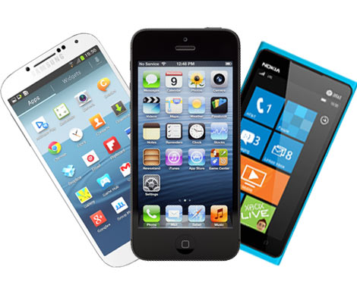
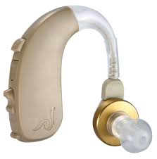
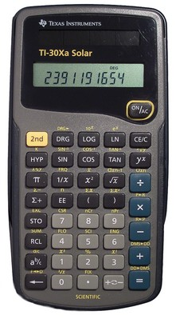
Computers
“A programmable electronic device designed to accept data”
(Mobile Orchestra, 2016)
(Hear Better, 2016)
(WPI, 2016)

Slide 3
Computers effects on education
Computers have benefited society's education
Teach people in hard to reach places
Teach those with educational disabilities
Distract the users from completing their work

Slide 4
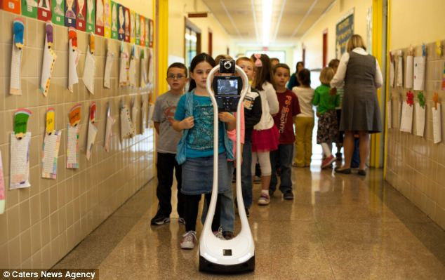
Computers can teach those in hard to reach places
Had surgery forcing him to stay home
Used robot to take his place in school
Didn’t miss out on any of the education he would have missed
(Robot at School, 2014)

Slide 5
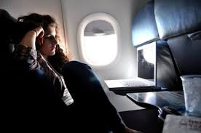
FLVS
“Whether you live in Florida or beyond, you can access more than 150 courses with us... Our courses are real—just like the certified teachers who teach them. Public, private, and homeschool students… High school students that have taken a course with FLVS have performed higher than the state average on End-of-Course and Advanced Placement (AP) exams”
(Girl on Plane, 2011)
(FLVS, 2016)

Slide 6
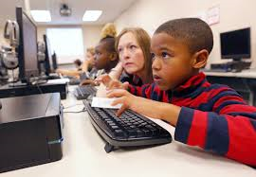
Aiding the educationally challenged
Create larger texts for visually impaired
Text can be repeated as often as necessary
The rate or pace can be adjusted for students who learn slower
The use of graphics, sound, and animation can help to motivate and encourage children to complete reading tasks more successfully.
(Child on Computer, 2014)

Slide 7
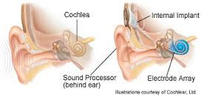
Provides help over educational obstacles
Allows for some who are deaf to hear again
Opens up new way to teach
Cochlear Implant, 2016

Slide 8
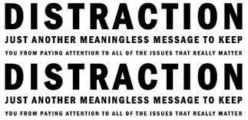
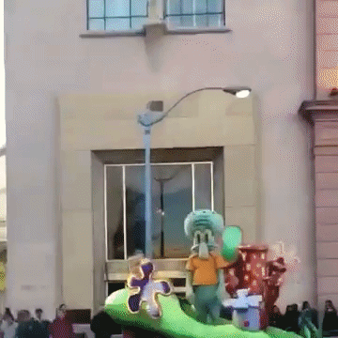
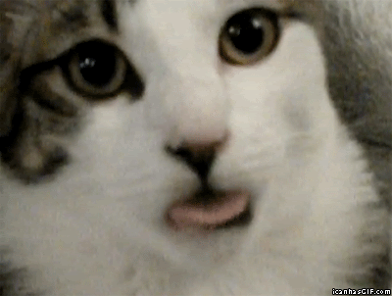
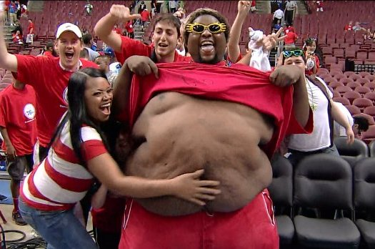
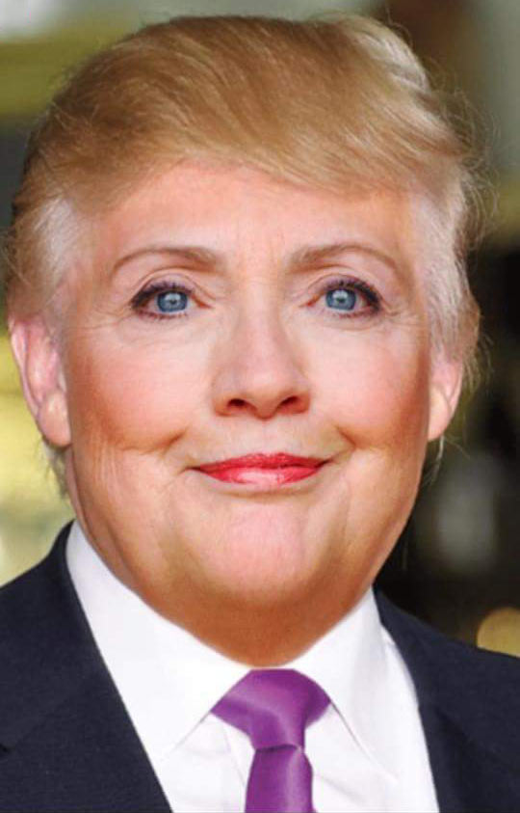
(Distracting Distractions, 2012)
(Cat with head Stuck In Bread, 2015)
(Squidward Dab, 2016)
(Distracting fan, 2012)
(Funny Cat Gifs, 2016)
(Hilary Trump, 2015)
(Honey boo boo, 2012)
(Loud Noises, 2013)

Slide 9
Computers distract us from educational activities
“When we retrieve information that was processed via multitasking or with significant interruptions from a secondary task, we are more likely to experience some form of performance decrement”
“Only 7.9 percent reported they never use a digital device during classes for non-classroom related activities.”
Distracted learning/ Multitasking while learning
Loss in education

Slide 10
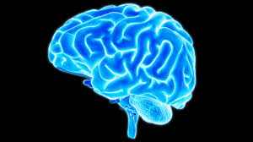
Computers effect the thinking process
Students lose focus
Cannot write long papers
(Brain, 2016)
(Child writing, 2016)

Slide 11
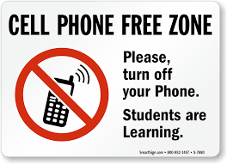
Solution
Limit the use of Computers in educational zones
Bringing kids up early
knowing computer device uses
Create modes on a computer to stop distractions
(Children on a Computer, 2016)
(No Cellphone, 2016)

Slide 12
References
[Photograph]. (2012). Retrieved from http://infospace.ischool.syr.edu/2012/03/17/internet-blackout-how-to- limit-online-distractions/
[Photograph]. (2016). Retrieved from https://gettrendygifs.wordpress.com/2016/01/28/new-trending-gif-tagged- squidward-dab-dabbing-swagward
Biswal, G. (2016). [Photograph]. Retrieved from http://fedobe.com/follow-some-rules-basic-guidelines-for- content-writing/
Boss, C. (2013). [Photograph]. Retrieved from http://www.dispatch.com/content/stories/local/2013/10/21/elementary-students-learn-to-type-to-take- tests.html
DR. ODD. (2016). [Photograph]. Retrieved from http://www.drodd.com/html4/funny-cat-gifs.html
Favim. (2011). [Photograph]. Retrieved from http://favim.com/image/79244/
Florida Virtual School. (2016). FLVS. Retrieved from https://www.flvs.net/
Greenfield, S. (2010, February). Computers in schools could do more harm than good. Retrieved from http://www.telegraph.co.uk/education/7220021/Computers-in-schools-could-do-more-harm-than- good.html
Hear Better. (2016). [Photograph]. Retrieved from https://www.hear-better.com/magento/
Imgur. (2013). Retrieved from http://imgur.com/gallery/EWFzV

Slide 13
Klausner, A. (2014, November 23). Sick boy goes to school as a ROBOT and interacts with students and teachers via computer. Retrieved from http://www.dailymail.co.uk/news/article-2845762/The- popular-bot-school-Sick-boy-goes-school-ROBOT-interacts-students-teachers-computer.html
Lee, A. (2012). [Photograph]. Retrieved from http://bleacherreport.com/articles/1214933-the-21-most- distracting-fans-in-sports
Mobile Orchestra. (2016). [Photograph]. Retrieved from http://www.mobileorchestra.com/choose-right- smartphone.html
National Geographic. (2016). [Photograph]. Retrieved from http://kids.nationalgeographic.com/explore/science/your-amazing-brain/
Rayner, G. (2014, March). Moment a deaf woman could hear for first time. Retrieved from http://www.telegraph.co.uk/news/health/10728006/Moment-a-deaf-woman-could-hear-for-first- time.html
Reddit. (2015). [Photograph]. Retrieved from https://www.reddit.com/r/gifs/comments/2y57y5/cat_with_head_stuck_in_bread
Reddit. (2015). [Photograph]. Retrieved from https://www.reddit.com/r/pics/comments/3xnfvb/hilary_trump/
Roos, L., & Lambert, K. (2016). Using Technology To Increase Literacy Skills. Retrieved from http://ttac.odu.edu/articles/litcy.html

Slide 14
Science Direct. (2016). Laptop multitasking hinders classroom learning for both users and nearby peers. Retrieved from http://www.sciencedirect.com/science/article/pii/S0360131512002254
SmartSign. (2016). [Photograph]. Retrieved from http://www.smartsign.com/no-cell-phone-signs/cell- phone-free-zone-sign/sku-s-7680.aspx
Statistic Brain. (2016). Computer Sales Statistics. Retrieved from www.statisticbrain.com/computer-sales- statistics/
University of Chicago medicine. (2016). [Drawing]. Retrieved from http://www.uchicagokidshospital.org/specialties/ent/hearing-loss/cochlear/about.html
Wise Geek. (2016). [Photograph]. Retrieved from http://www.wisegeek.com/what-are-the-different-types- of-computer-software-for-kids.htm

